Slide 1


A PROJECT REVIEW ON ELECTRIC-DRIVE RECONSTRUCTED ONBOARD CHARGER FOR SOLAR POWERED ELECTRIC VEHICLES INCORPORATING
SIX PHASE MACHINE Submitted To JAWAHARLAL NEHRU TECHNOLOGICAL UNIVERSITY, ANANTHAPURAMU In partial fulfillment of the requirements for the Award of the Degree of BACHELOR OF TECHNOLOGY IN ELECTRICAL AND ELECTRONICS ENGINEERING Submitted by
GUDIMETLA SNEHANJALI (219E1A0222)
MALLA YASHWANTHI (219E1A0242)
E DURGASRI (219E1A0217)
MEKALA SNEHA LATHA (219E1A0245)
KODIKANTI GREESHMA (219E1A0231)
Under the esteemed guidance of
Mrs. K. Prathibha, M. Tech., (Ph.D).,
ASSISTANT PROFESSOR DEPARTMENT OF ELECTRICAL AND ELECTRONICS ENGINEERING SRI VENKATESWARA ENGINEERING COLLEGE
(Approved by AICTE, New Delhi, NBA & NAAC Accredited Institution with UGC section 2(f) & 12(b)& Affiliated to JNTUA, Anantapuramu)
Karakambadi Road, Tirupati- 517507 (2021-2025)

Slide 2
CONTENTS
Abstract
Literature Survey
Existing Method and Drawbacks
Problem Identification
Proposed method
Project block diagram
System Configurations
Simulation Circuit
Project Working
Source code
Simulation results
Advantages and Applications
Software configuration
References and Base papers

Slide 3
ABSTRACT
EDROC FOR SOLAR POWERED EV INCORPORATING SIX PHASE MACHINE
EDROC Proposal: A novel Electric-Drive-Reconstructed Onboard Charger (EDROC) for solar-powered electric vehicles.
Six-Phase Drive & Re-leveraged Inverter: Utilizes a six-phase machine drive and re-leverages the power traction inverter for charging.
Simultaneous Operation: Enables simultaneous driving and charging through vehicle-roof photovoltaic panels.
Extended EV Range: Significantly enhances the vehicle’s mileage range by using solar energy for both driving and charging

Slide 4
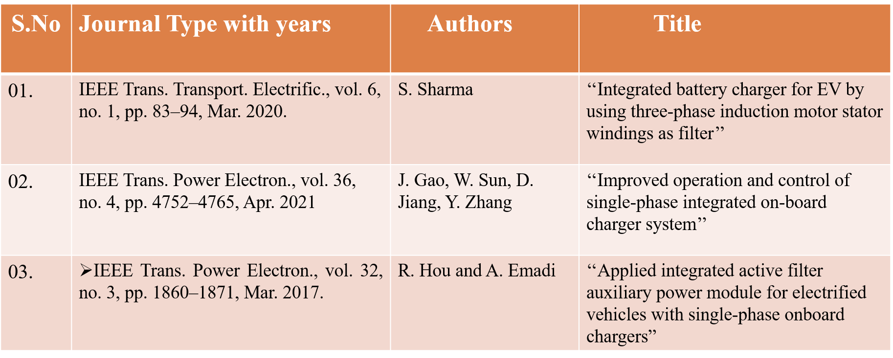
LITERATURE SURVEY

Slide 5
EXISTING SYSTEM AND DRAWBACKS
EDROC Incorporating Three-phase Machine:
In the existing system, in existing method EDROC is constructed using 3phase machine and active filter to double the frequency.
Additionally, a split-windings machine is employed to mitigate the issue of generating non-negligible torque, ensuring smoother operation.
DISADVANTAGES:
Less fault tolerant capacity
Less grid voltage quality
Bulky Components

Slide 6
PROBLEM IDENTIFICATION
The EDROC system has limited fault tolerance, increasing the risk of failures in critical applications.
Poor grid voltage quality negatively impacts the performance and efficiency of connected devices.
Bulky components complicate installation and raise transportation costs, hindering compact design integration.
These issues lead to higher overall costs, making the system less economically viable for widespread use.
The design lacks scalability, limiting future expansions and adaptability to evolving technological needs.

Slide 7
PROPOSED METHOD
EDROC Incorporating six-phase Machine:
This system introduces a novel onboard charger (EDROC) for solar-powered EVs using a six-phase motor drive.
It repurposes the traction inverter and motor for charging, reducing extra weight.
Additionally, it enables simultaneous driving and charging via rooftop solar panels, extending the EV's range.

Slide 8
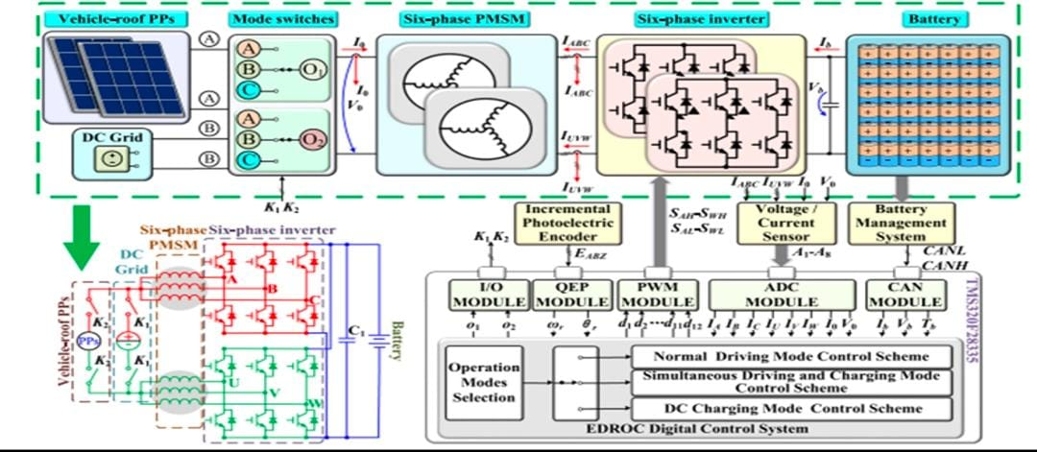
PROJECT BLOCK DIAGRAM

Slide 9
SYSTEM CONFIGURATION
Solar PV PPS : It manages the flow of electrical power within the vehicle.
Like : DC-DC converters, DC-AC inverters, etc.,
DC Grid : It supplies DC power for the system
Like: electric motor, batteries,etc.,
Six-Phase PMSM (Permanent Magnet Synchronous Motor):
A electric motor that is used for their high efficiency, reliability, and power density.
Six-Phase Inverter : It convers DC power to AC power.
EDROC Digital Control System :
It controls and monitors the vehicle's electrical powertrain,
Like: Motor control, Power management , Safety features

Slide 10
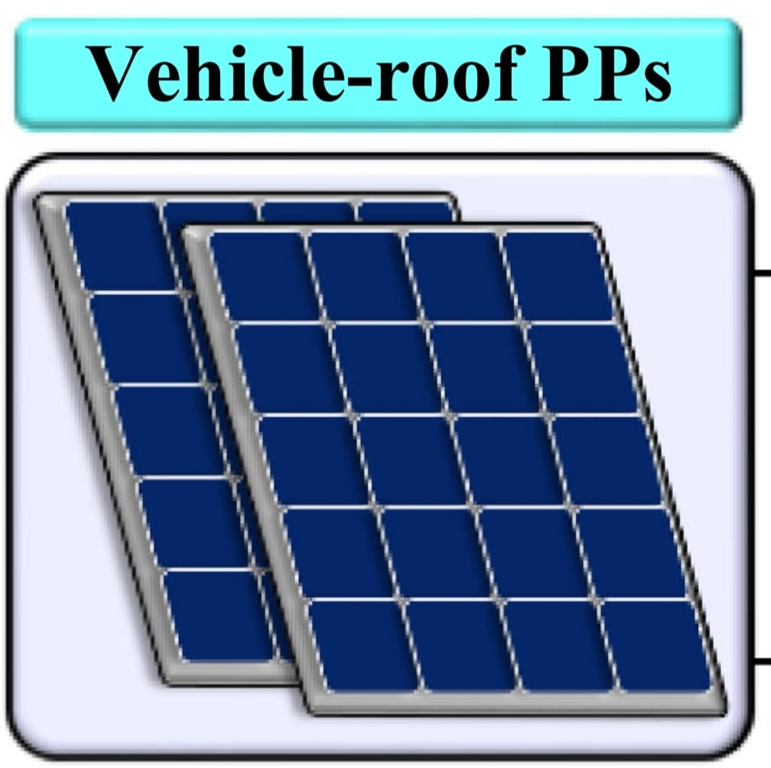
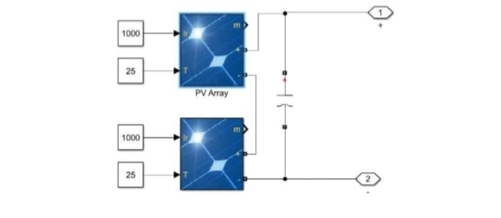
SYSTEM CONFIGURATION
PV ARRAY
Subsystem of PV array

Slide 11
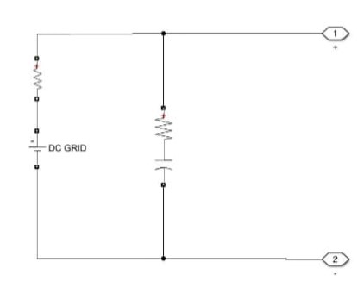
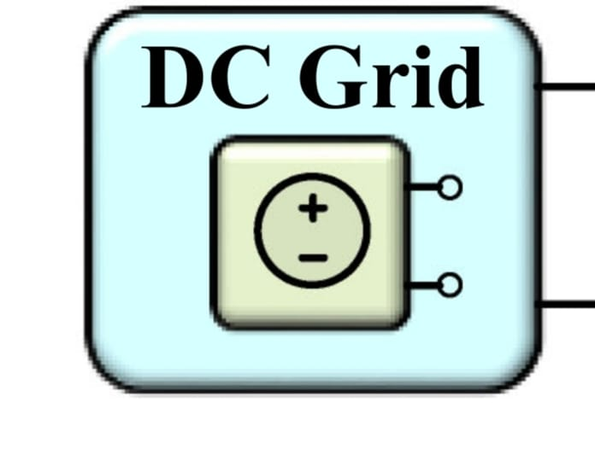
SYSTEM CONFIGURATION
DC GRID
Subsystem of DC GRID

Slide 12
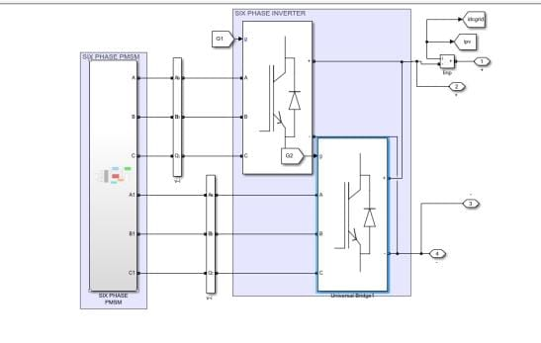
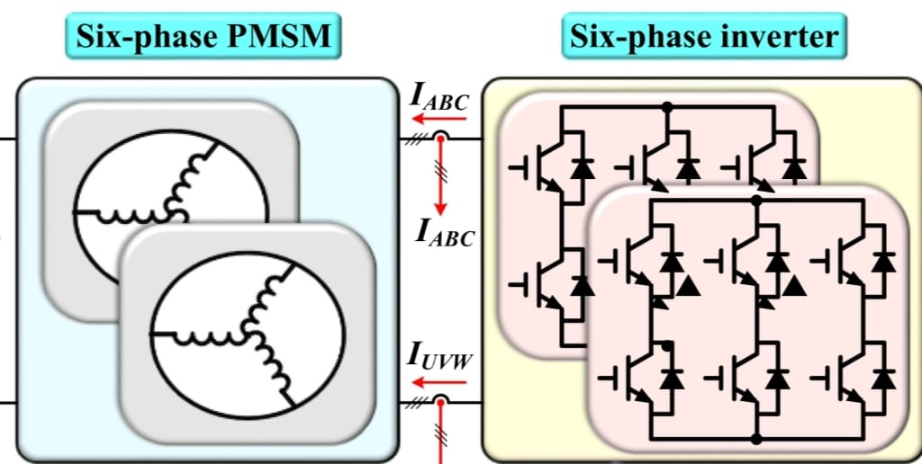
SYSTEM CONFIGURATION
6 PHASE MOTOR AND INVERTER
Subsystem of 6 PHASE MOTOR AND INVERTER

Slide 13
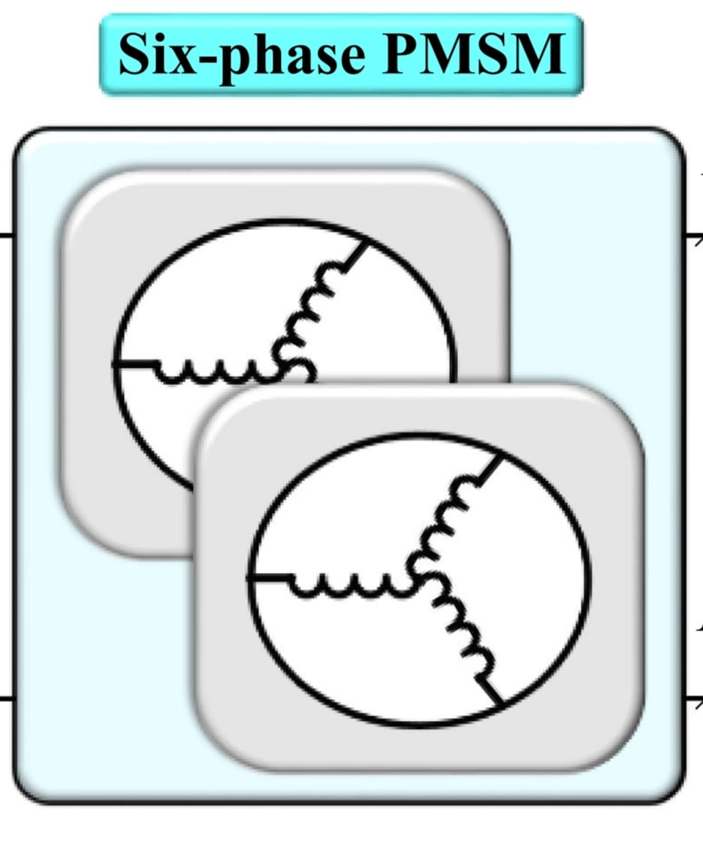
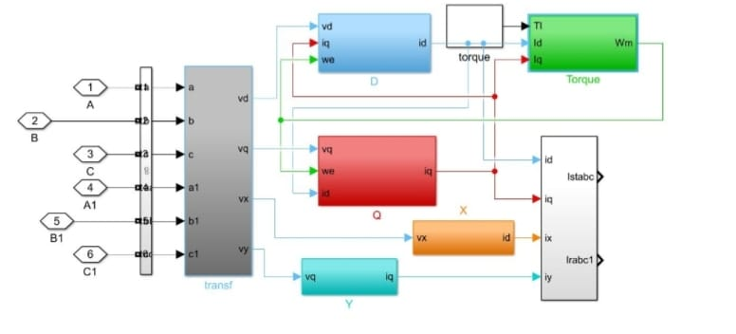
SYSTEM CONFIGURATION
6 PHASE PMSM MOTOR
Subsystem of 6 PHASE PMSM MOTOR

Slide 14
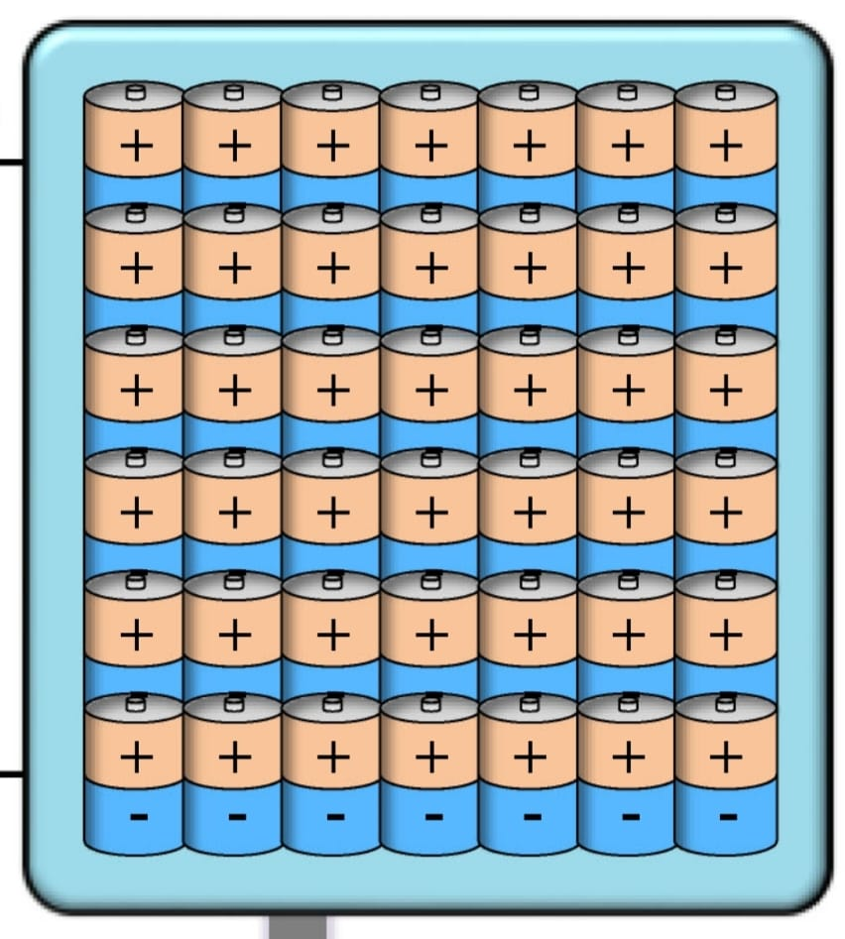
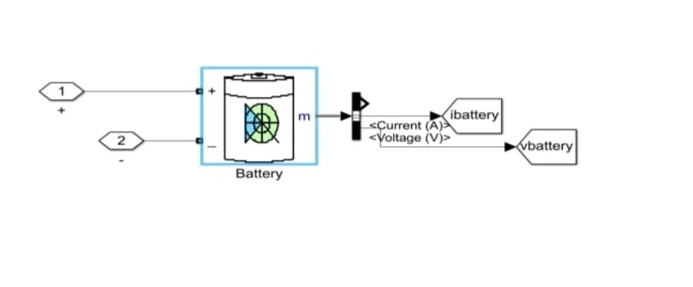
SYSTEM CONFIGURATION
BATTERY
Subsystem of PV array

Slide 15
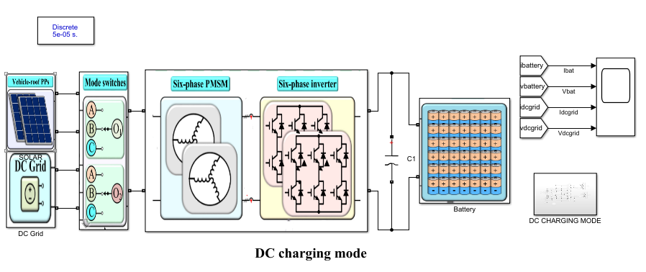
PROJECT CIRCUIT AND WORKING:
DC CHARGING MODE:

Slide 16
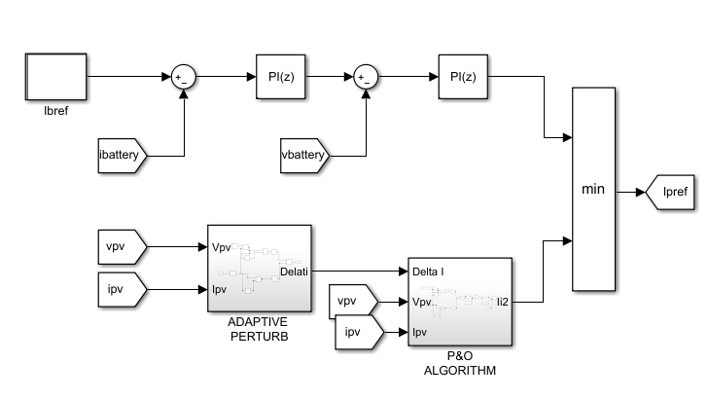
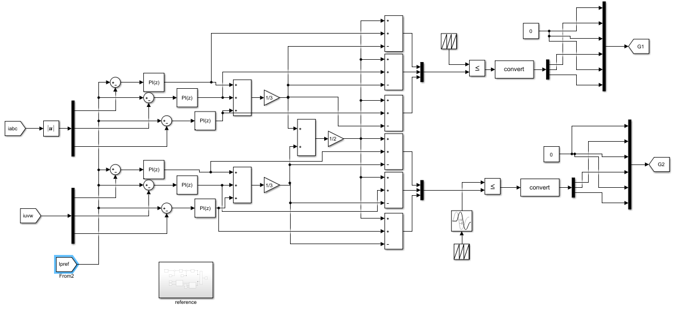
PROJECT WORKING:
Controlling part
Reference current

Slide 17
SOURCE CODE:
STEADY STATE PARAMETERS:
%% parameters pv side
%% six phase pmsm
prasi=2e3;
time=[0 0.5];
torquel=[4.5 4.5];
wrated=2000;
np=5;
R=0.3;
ld=5.56e-3;
lq=7e-3;
oaxis=0.125e-3;
rphas=0.3;
fluxsta=0.042;
ja=0.02;
%% battery side
ratbat=50;
vba=144;
imaxchar=25;
imaxdisc=25;
DYNAMIC STATE PARAMETERS:
%% parameters pv side
%% six phase pmsm
prasi=2e3;
time=[0 0.5];
torquel=[8 4.5];
wrated=2000;
np=5;
R=0.3;
ld=5.56e-3;
lq=7e-3;
oaxis=0.125e-3;
rphas=0.3;
fluxsta=0.042;
ja=0.02;
%% battery side
ratbat=50;
vba=144;
imaxchar=25;
imaxdisc=25;

Slide 18
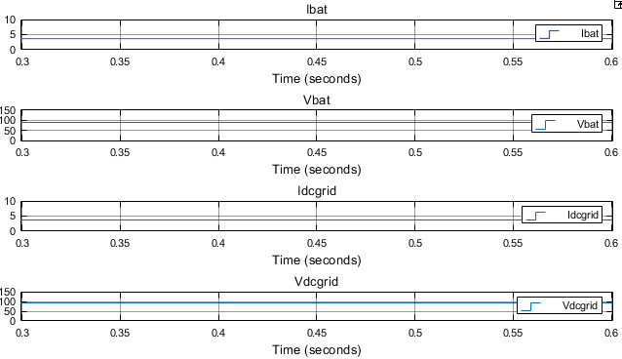
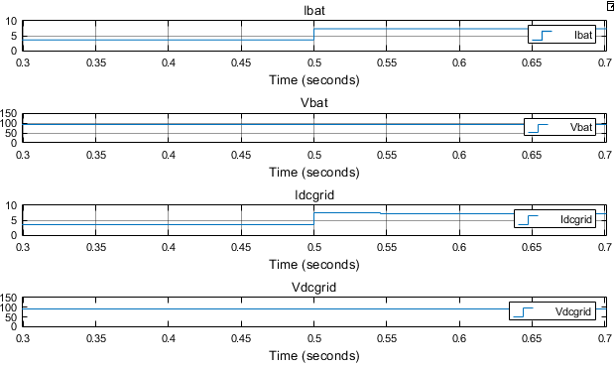
SIMULATION RESULTS:
DC CHARGING MODE WHEN CONNECTED TO DC GRID:
DYNAMIC STATE MODE:
STADY STATE MODE

Slide 19
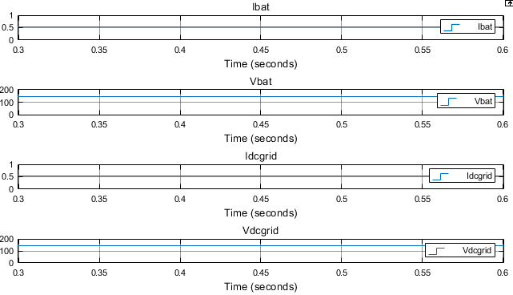
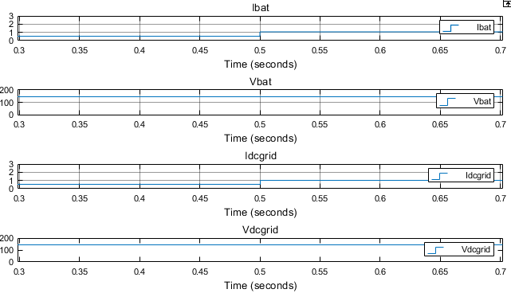
SIMULATION RESULTS:
DC CHARGING MODE WHEN CONNECTED TO SOLAR PV:
STADY STATE MODE
DYNAMIC STATE MODE

Slide 20
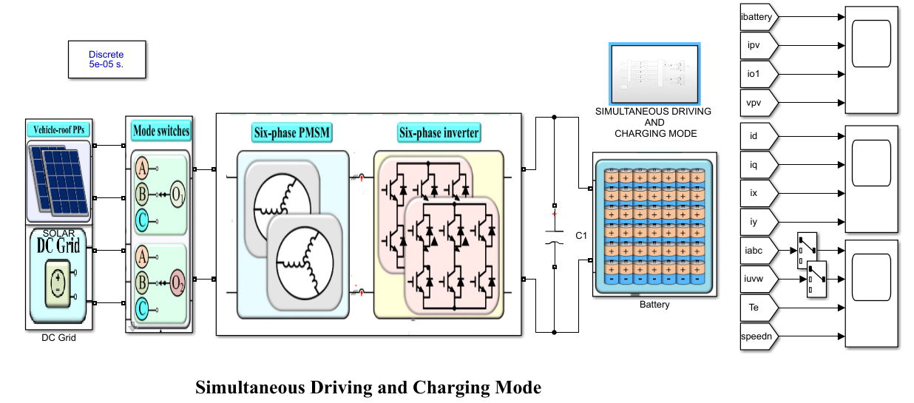
PROJECT WORKING:
SIMUTANIOUS DRIVING AND CHARGING MODE:

Slide 21
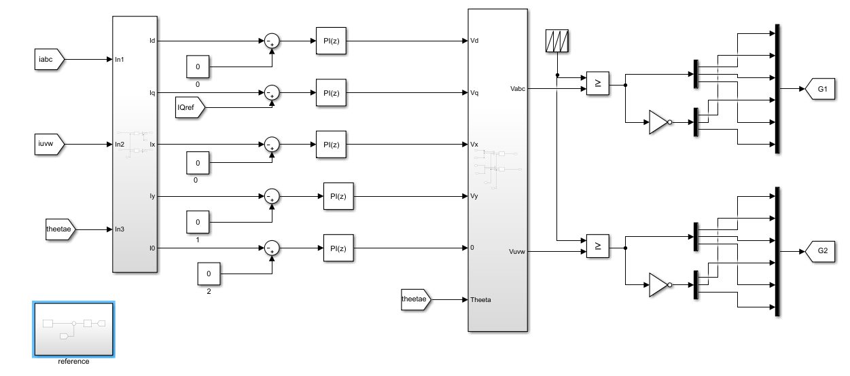
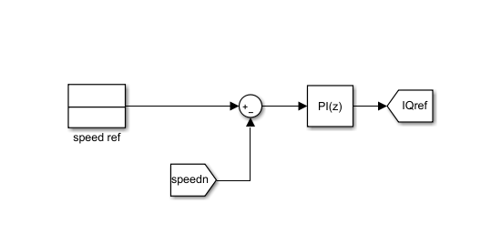
PROJECT WORKING:
Controlling part
Speed Controller

Slide 22
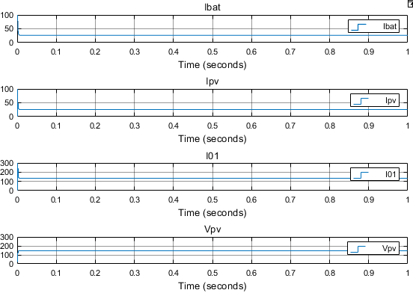
SIMULATION RESULTS:
SIMULTANEOUS CHARGING AND DRIVING MODE :
PPs output current and voltage, battery current and 01-axis current.

Slide 23
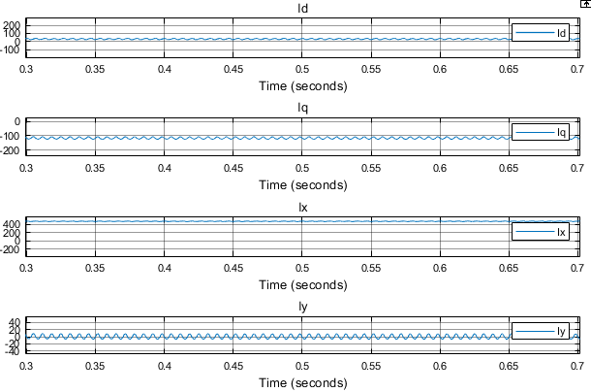
SIMULATION RESULTS:
SIMULTANEOUS CHARGING AND DRIVING MODE :
Currents in d-axis, q-axis, x-axis, and y-axis.

Slide 24
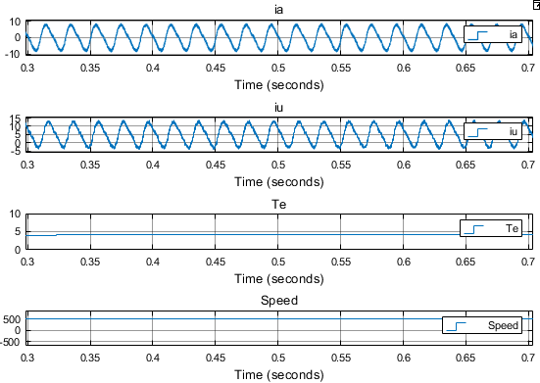
SIMULATION RESULTS:
SIMULTANEOUS CHARGING AND DRIVING MODE :
LOAD AND SPEED CONSTANT:
Currents in phase A and U, speed, and output torque

Slide 25
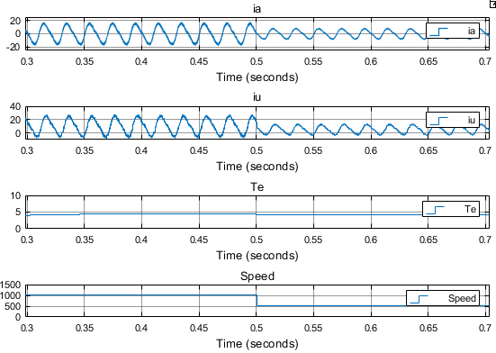
SIMULATION RESULTS:
SIMULTANEOUS CHARGING AND DRIVING MODE :
Speed variable and constant Load:
Currents in phase A and U, speed, and output torque

Slide 26
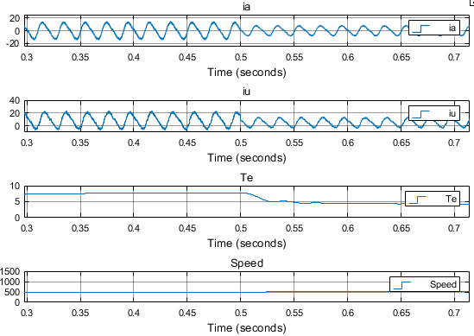
SIMULATION RESULTS:
SIMULTANEOUS CHARGING AND DRIVING MODE :
Load variable and Speed constant:
Currents in phase A and U, speed, and output torque

Slide 27
ADVANTAGES & APPLICATIONS
ADVANTAGES:
High fault tolerating capacity
Voltage quality is improved
Simultaneous charging and driving
Decreased mass
APPLICATIONS:
Electric vehicles
E.V. charging stations

Slide 28
SOFTWARE CONFIGURATION:
Software Configuration:
Operating System : Windows 7/8/10/11/12
Application Software : MATLAB /Simulink 2018A
Hardware Configuration:
Hardware : WINDOWS OS
RAM : 8 GB / 4 GB (Min)
Processor : I3 / I5(Mostly prefer)

Slide 29
REFERENCES:
R. Hou and A. Emadi, “Applied integrated active filter auxiliary power module for electrified vehicles with single-phase onboard chargers,” IEEE Trans. Power Electron., vol. 32, no. 3, pp. 1860–1871, Mar. 2017.
D. Abeywardana, P. Acuna, and B. Hredzak, “Single-phase boost inverterbased electric vehicle charger with integrated vehicle to grid reactive power compensation,” IEEE Trans. Power Electron., vol. 33, no. 4, pp. 3462–3471, Apr. 2018.
H. Raherimihaja, Q. Zhang, and T. Na, “A three-phase integrated battery charger for EVs based on six-phase open-end winding machine,” IEEE Trans. Power Electron., vol. 35, no. 11, pp. 12122–12132, Nov. 2020.
M. Tong, M. Cheng, and W. Hua, “A single-phase on-board two-stage integrated battery charger for EVs based on a five-phase hybrid-excitation flux-switching machine,” IEEE Trans. Veh. Technol., vol. 69, no. 4, pp. 3793–3804, Apr. 2020.
S. Sharma, M. Aware, and A. Bhowate, “Integrated battery charger for EV by using three-phase induction motor stator windings as filter,” IEEE Trans. Transport. Electrific., vol. 6, no. 1, pp. 83–94, Mar. 2020.

Slide 30


